Slide 1

IT2060
Operating Systems and System Administration
Lecture 05
Mass Storage Scheduling

Slide 2
Disk Scheduling
The operating system is responsible for using hardware efficiently — for the disk drives, this means having a fast access time and disk bandwidth
Minimize seek time
Seek time ≈ seek distance
Disk bandwidth is the total number of bytes transferred, divided by the total time between the first request for service and the completion of the last transfer

Slide 3
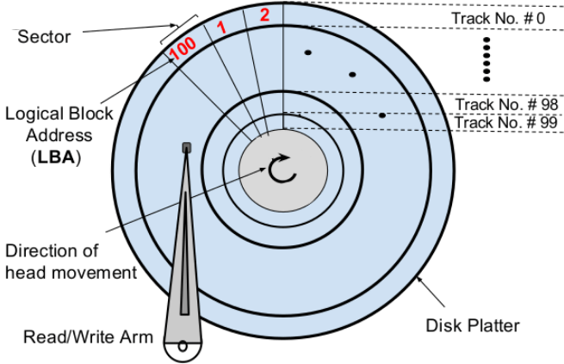
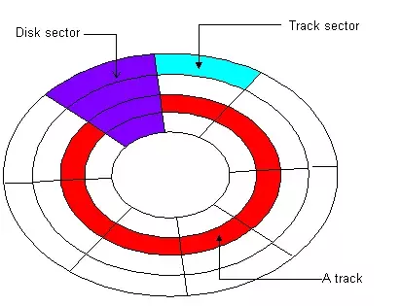

Slide 4
Disk Scheduling (Cont.)
Note that drive controllers have small buffers and can manage a queue of I/O requests (of varying “depth”)
Several algorithms exist to schedule the servicing of disk I/O requests
The analysis is true for one or many platters
We illustrate scheduling algorithms with a request queue (0-199)
98, 183, 37, 122, 14, 124, 65, 67
Head pointer 53

Slide 5
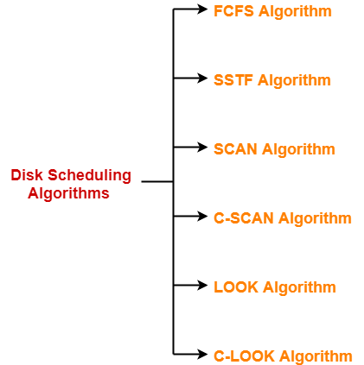
Disk Scheduling

Slide 6
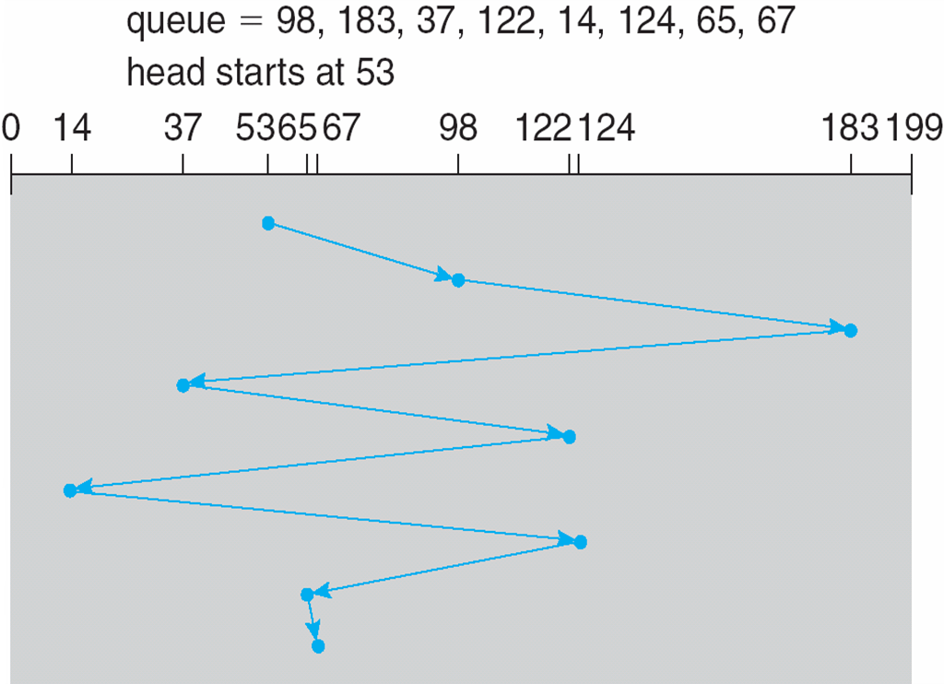
FCFS
Illustration shows total head movement of 640 cylinders

Slide 7
SSTF
Shortest Seek Time First selects the request with the minimum seek time from the current head position
SSTF scheduling is a form of SJF scheduling; may cause starvation of some requests
Illustration shows total head movement of 236 cylinders

Slide 8
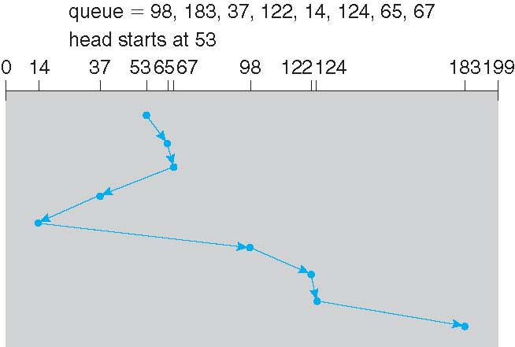
SSTF (Cont.)

Slide 9
SCAN
The disk arm starts at one end of the disk, and moves toward the other end, servicing requests until it gets to the other end of the disk, where the head movement is reversed, and servicing continues.
SCAN algorithm Sometimes called the elevator algorithm
Illustration shows total head movement of 236 cylinders
But note that if requests are uniformly dense, largest density at other end of disk and those wait the longest

Slide 10
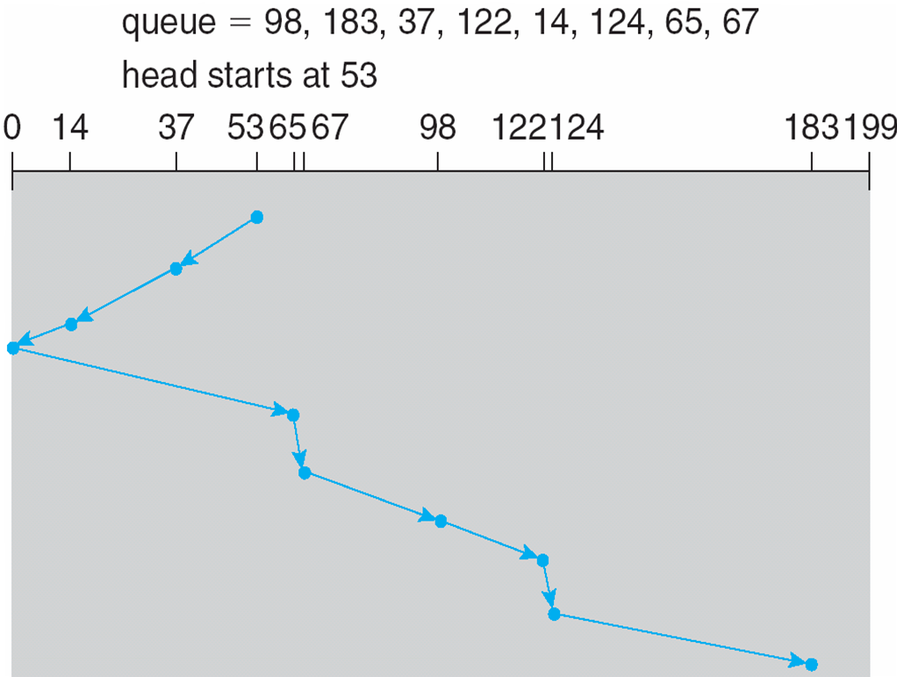
SCAN (Cont.)

Slide 11
C-SCAN
Provides a more uniform wait time than SCAN
The head moves from one end of the disk to the other, servicing requests as it goes
  When it reaches the other end, however, it immediately returns to the beginning of the disk, without servicing any requests on the return trip
Treats the cylinders as a circular list that wraps around from the last cylinder to the first one
Total number of cylinders?

Slide 12
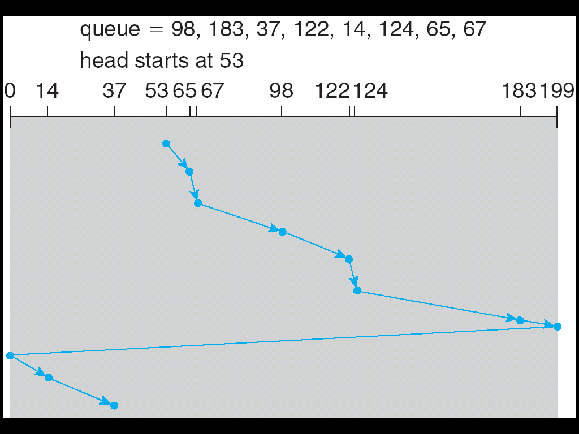
C-SCAN (Cont.)

Slide 13
Look Scheduling
The LOOK algorithm services request similarly as SCAN algorithm meanwhile it also “looks” ahead as if there are more tracks that are needed to be serviced in the same direction.
If there are no pending requests in the moving direction the head reverses the direction and start servicing requests in the opposite direction.

Slide 14
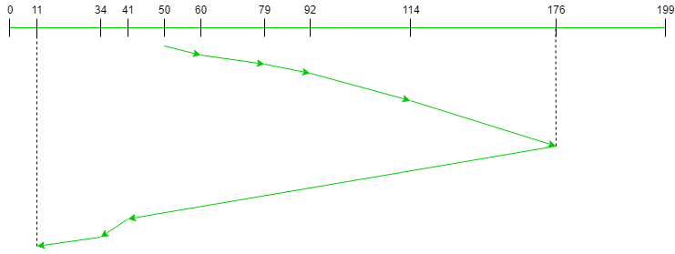
Look (Cont.)
Request sequence = {176, 79, 34, 60, 92, 11, 41, 114} Initial head position = 50 Direction = right (We are moving from left to right)

Slide 15
C-LOOK
LOOK a version of SCAN, C-LOOK a version of C-SCAN
Arm only goes as far as the last request in each direction, then reverses direction immediately, without first going all the way to the end of the disk
Total number of cylinders?

Slide 16
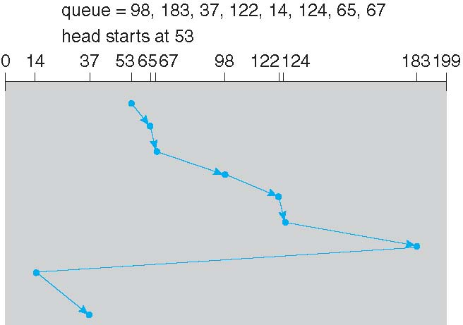
C-LOOK (Cont.)

Slide 17
End of Lecture 5

